Slide 1
Self adjusted auto provision system at resource level
Progress report 28th May
You Hu

Slide 2
Agenda
Recap
Plan
Details of current implementation
Master-worker Arch
Fault tolerance
Issues not completely solved
TODO and Problems

Slide 3
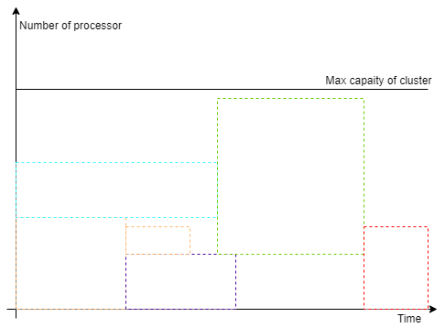
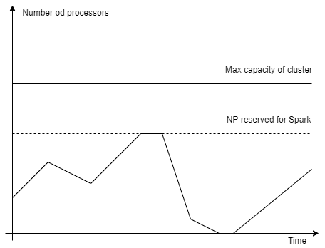
Recap – issue and research question
Existing solutions resulting resource waste

Slide 4
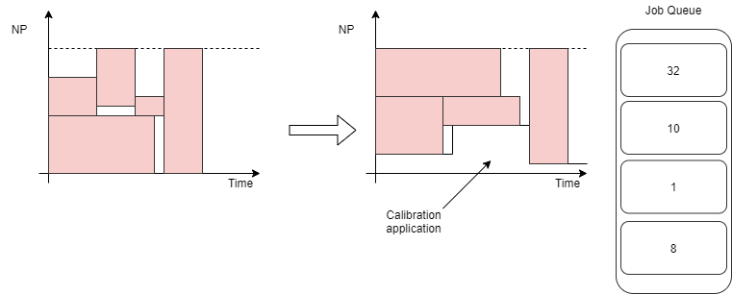
Recap – issue and research question
How to increase the resource utilization level in a batch cluster?
Use calibration applications to fill in the blank.
It requires: auto scaling/provisioning;

Slide 5
Recap - Questions statement (One month ago)
Distributed algorithm/architecture: Master – worker
Communication: IPL -> Ibis server(s-for backup)
Resource management algo:
Estimate job execution time
Schedule->SLURM+Xenon
Dynamic adjust: a metrics for trading off(time to start and shut down nodes)
Fault tolerance
Node manage: master->re-election; worker->task persistence
Tasks(NO snapshot): Zookeeper/Redis/any lightweight distributed database
Data locality: move comp rather than move data
Remote sites
Shared storage
Data aware(?)

Slide 6
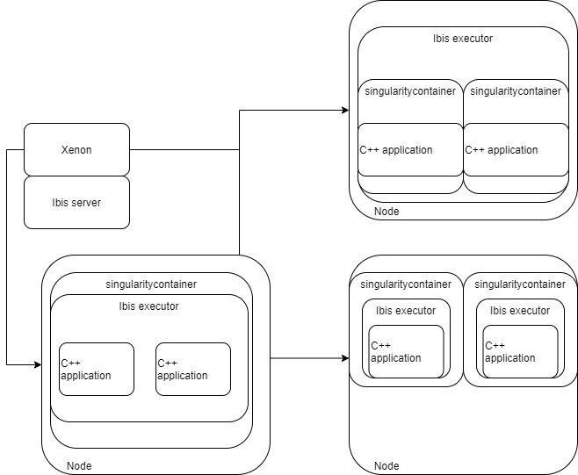
Possible arch solutions
Node-IbisExe-(Multi)Container-Application
Node-Container-IbisExe-(Multi)Application
Node-(Multi)Container-IbisExe-Application

Slide 7
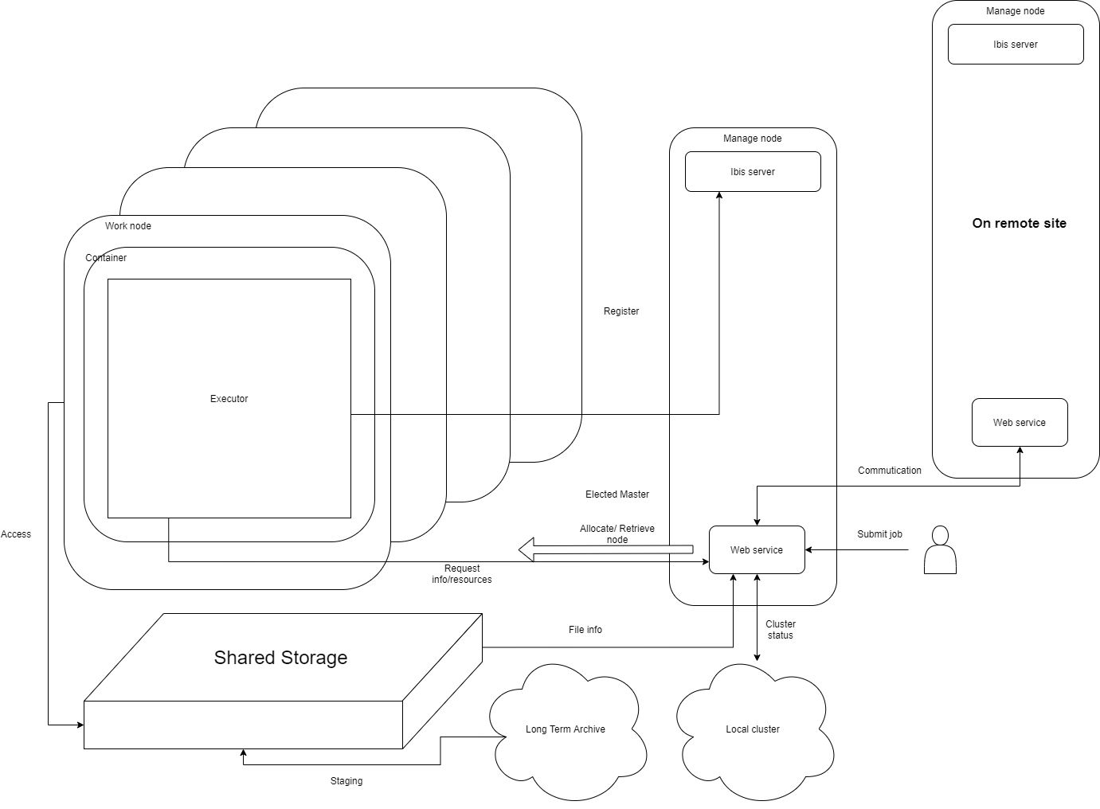
System design 0.2.1
One cluster->multiple nodes
One node->one container
One container->one driver
SAGECAL employs multi-thread

Slide 8
Plan
Master-worker on DAS5 (Finished) using Word Count as debug case
Simple JNI is available, but integrate Sagecal is a problem, system call as a replacement for now
Fault tolerance (Finished); issue: Too Slow for failure detection
Auto-scaling: monitoring and scaling policy (Est. 2-3 weeks)
Cross region: web server handle it (Est. 1-2 weeks)
Plus: handling failure of Ibis server(remote site backup)
Literature study

Slide 9
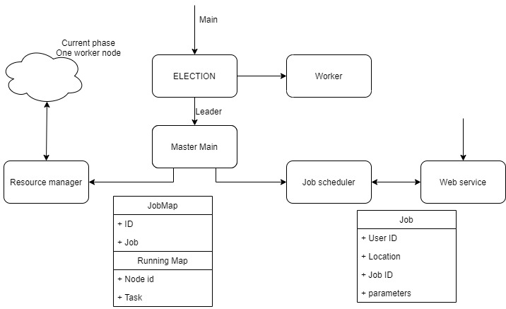
Simple Design
Same code, Different action
DAS5 provides uniformed namespace

Slide 10
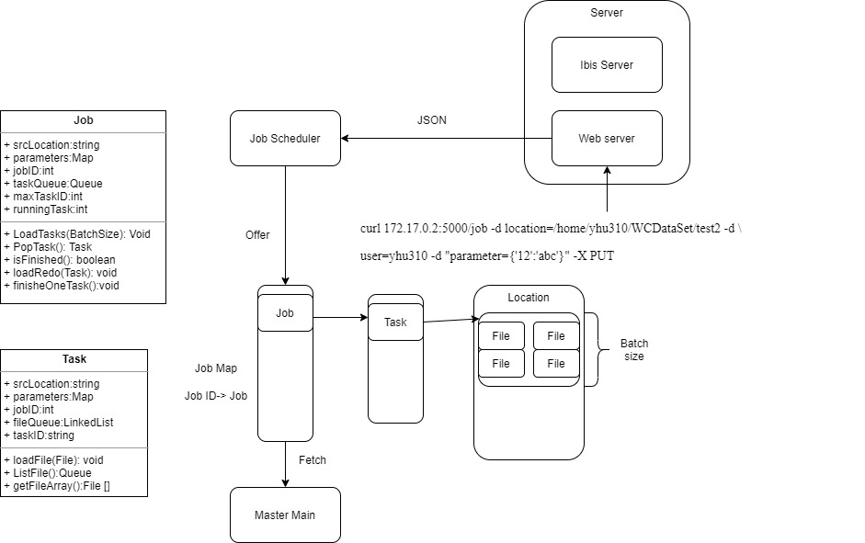
Job submission
RestFul API
Job loads files to tasks

Slide 11
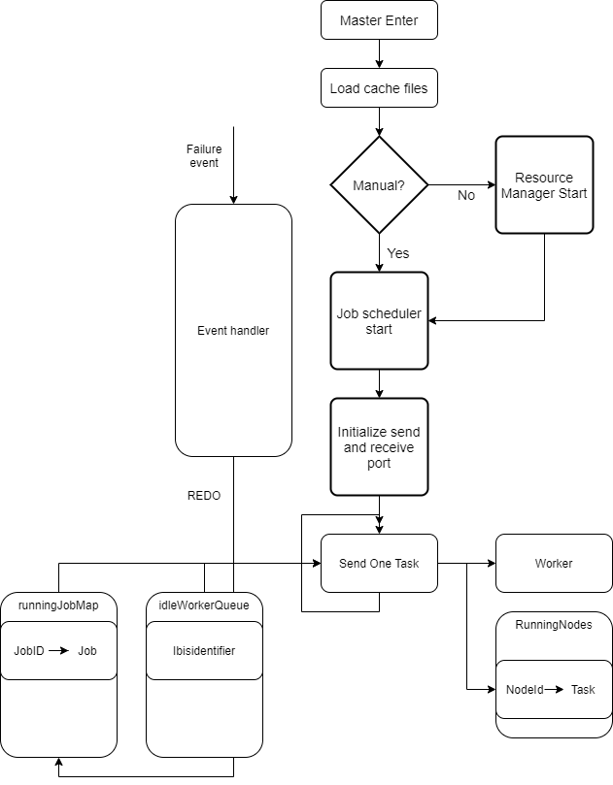
Master main
First initial settings
Then loops for task deliver
If idleWorkerQueue not empty && runningJobMap not empty
Fetch a Task from runningJobMap and a ibisIdentifier from idleWorkerQueue
Send
If success: Add pair <ibisIdentifier, Task> to RunningNodes
If failed(connection failed): pop a new ibisIdentifier, Send again
If idleWorkerQueue is empty: redo Task, and end this section
FIFO Job/Task Queue
Tree map: sorted via the key(Job Id)
Pop task: iterate, if taskQueue is not empty, pop a task, else next job(with ascending order by the JobId）

Slide 12
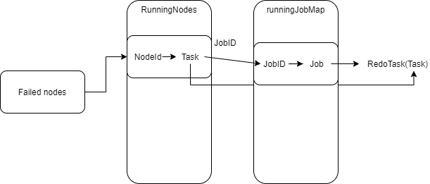
Master check failed
EventHandler receive died events
According to the id of failed node, redo the task
Caching the RunningJobMap and the tasks on RunningNodes

Slide 13
Worker main
Init ports
Send a init controlMessage to master notify an active node join
Loop (finished==false)
Fetch a Task from workerTaskQueue
Process the Task with given: location, parameters
Send back the result to master
Upcall: receive task from master and push to workerTaskQueue
Any time detect fail of master, forcedly terminate the task and reelection

Slide 14
Fault tolerance
Worker failed
Master detects the failed nodes
Redo the task
Master failed
Pre-processing: periodically snapshots
Worker detects master failing
Reelection
New master load the snapshot
Server(TODO)
Ideally using backup site; and switch back when server is avalible

Slide 15
Issues
The failure detection(event handler) takes 1-2 mins
For worker’s failure its ok
For master failure, it costs too much
Is it possible to configure the heartbeat time intervals?
Snapshot of running jobs
Build-in serialization+Input/Output Stream always EOFException
Integrate SAGECAL With JNI
Currently using ubuntu:bionic as base container

Slide 16
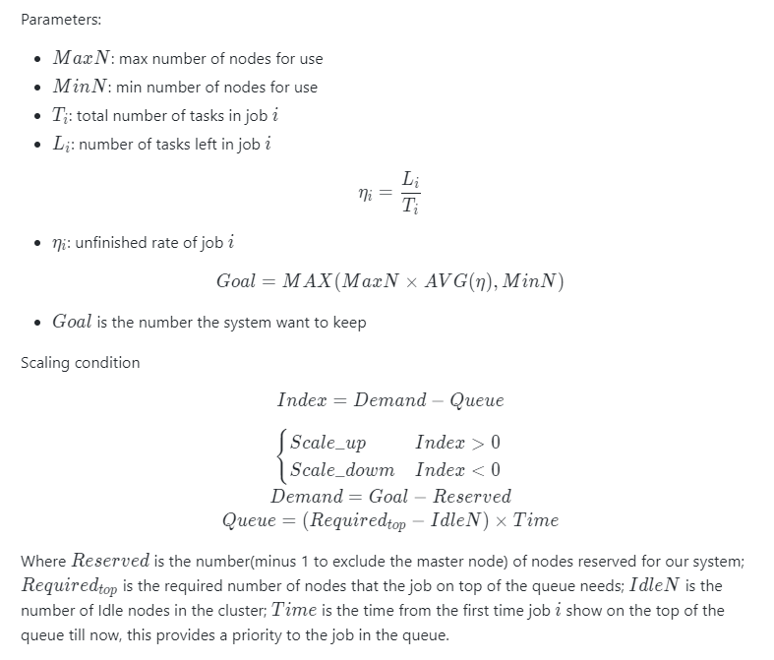
TODO – auto-scaling
What is the scheduling policy on DAS5?
Strict FIFO /priority Queue? Preemptive? Fill back?
How to configure the scheduler arguments?
description.setSchedulerArguments();
How to scale down elegantly? Force kill or notify and end by itself?

Slide 17
TODO – performance evaluation
Metrics: resource utilization rate; speedup compare to MPI and Spark
Resource utilization: probation of idle worker
Speedup: from the time submitting job to the time job finished
Require: reproducible test environment
Simulate incoming jobs (with various setting: NP, execute time)
Data set with different size (100MB, 1GB, 5GB or more? What is LOFAR daylily case?)

Slide 18
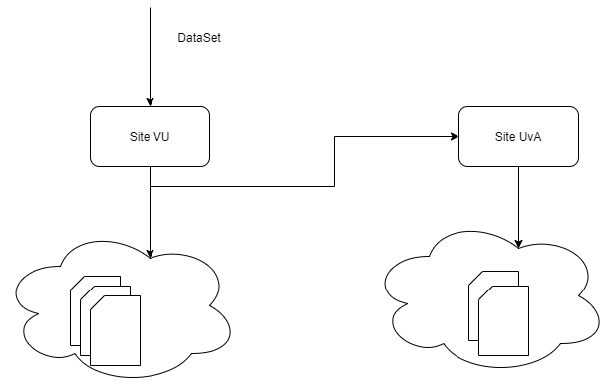
TODO – cross region
The data set will be partitioned into multiple sub set
Server split and transfer job to other sites
The output file should be transferred and collected
Or shared folder among clusters

